Slide 1
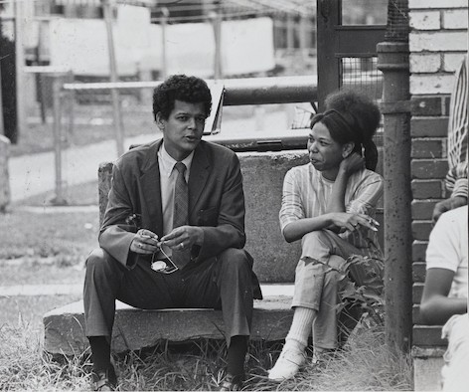
Bond Papers x Data Science: A Brief Overview
Charlie Perez

Slide 2
Contents
Where to find things
GitHub and Teams
Pipeline-level work
PDF automation
FTP-to-Drupal Transfer
Analysis-level work
Mapping the Speeches of Julian Bond
Semantic Similarity Search

Slide 3
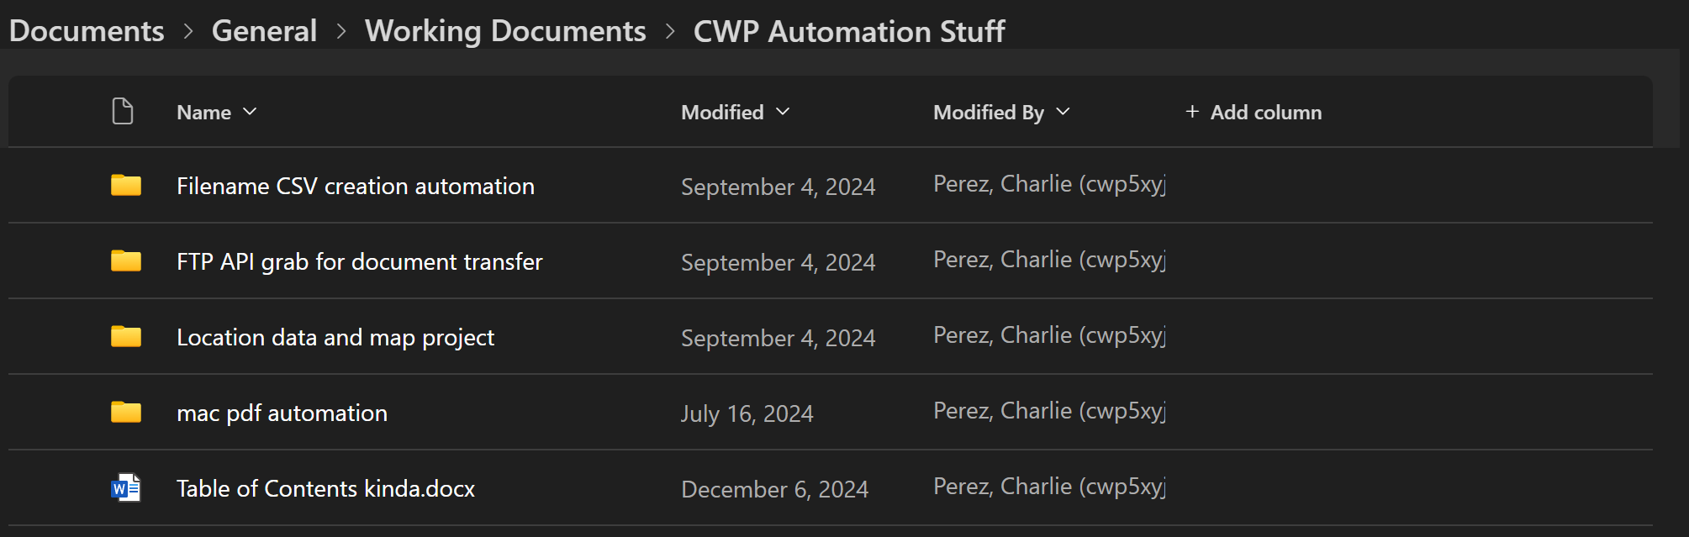
MS Teams
In 2024-25 Apprentices of Julian Bond
Contains everything that is currently an active part of the Project workflow, and then some

Slide 4
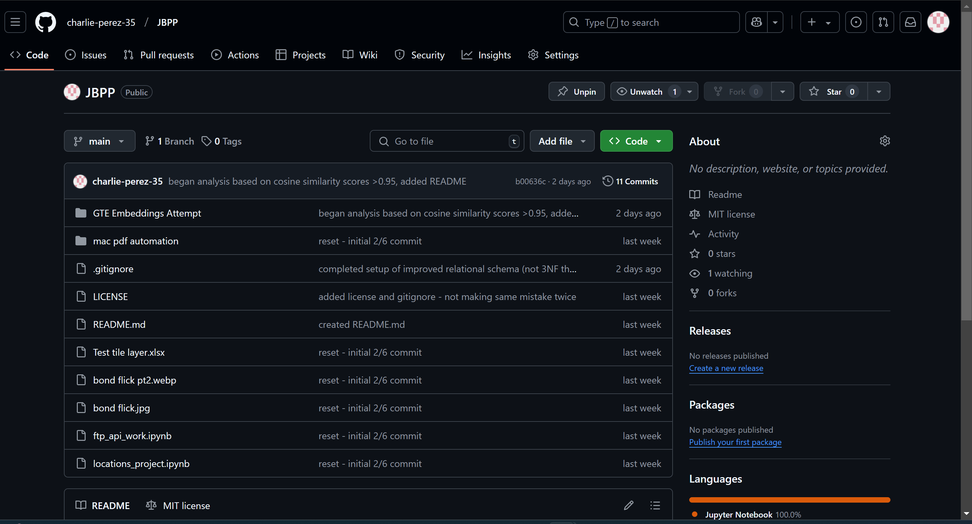
GitHub
https://github.com/charlie-perez-35/JBPP

Slide 5


Level 1: Pipelines

Slide 6

From DPG: PDF creation and filename CSVs
“Mac PDF automation”: shell scripts designed to be run directly from the DPG computers to convert TIFF images to PDFs without manually clicking
For use by scanners, documented in Teams and GitHub
“Filename CSV creation automation”: Designed to save Dr. Baker time, takes text file of image filenames and automatically converts them to the CSV format required by our Drupal editors
For use by scanners (does require using Google Colab and running a Python Notebook, but well documented)
Both could be obsolete soon

Slide 7
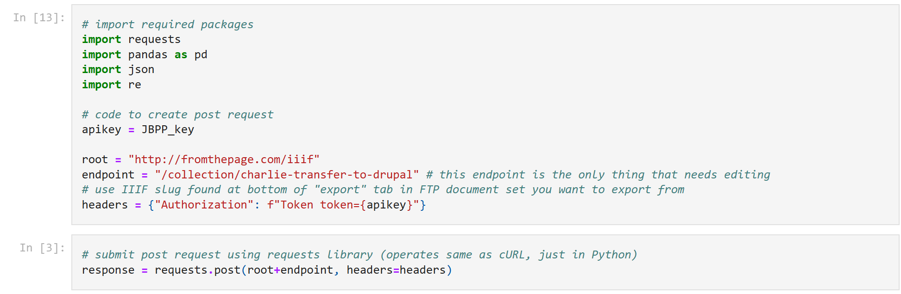
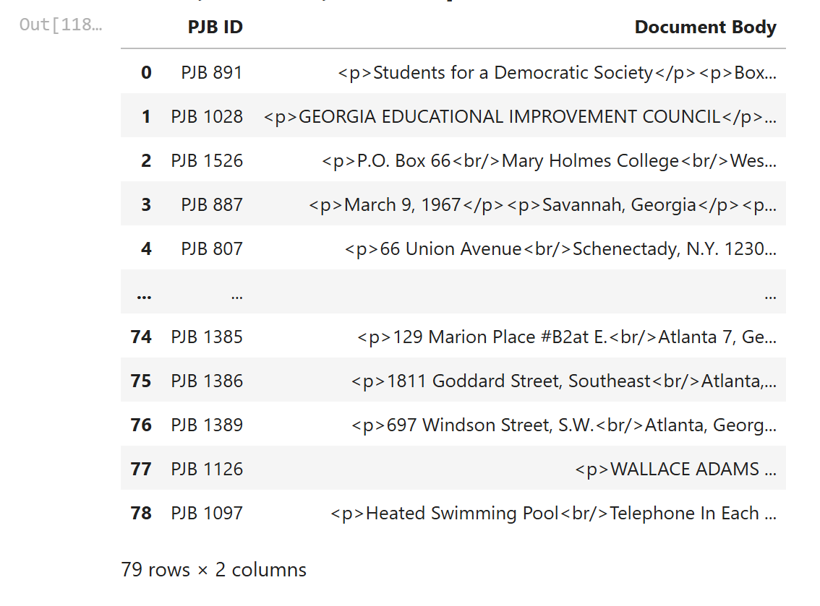
From FTP to Drupal: importing completed transcriptions
Most comprehensive and useful pipeline
Python notebook that is almost fully contained
Takes contents of “Transfer to Drupal” folder and converts into CSV that Dr. Baker can upload to Drupal
Only possible improvement would be making it a .py file with a user interface

Slide 8

Level 2: Analytics

Slide 9
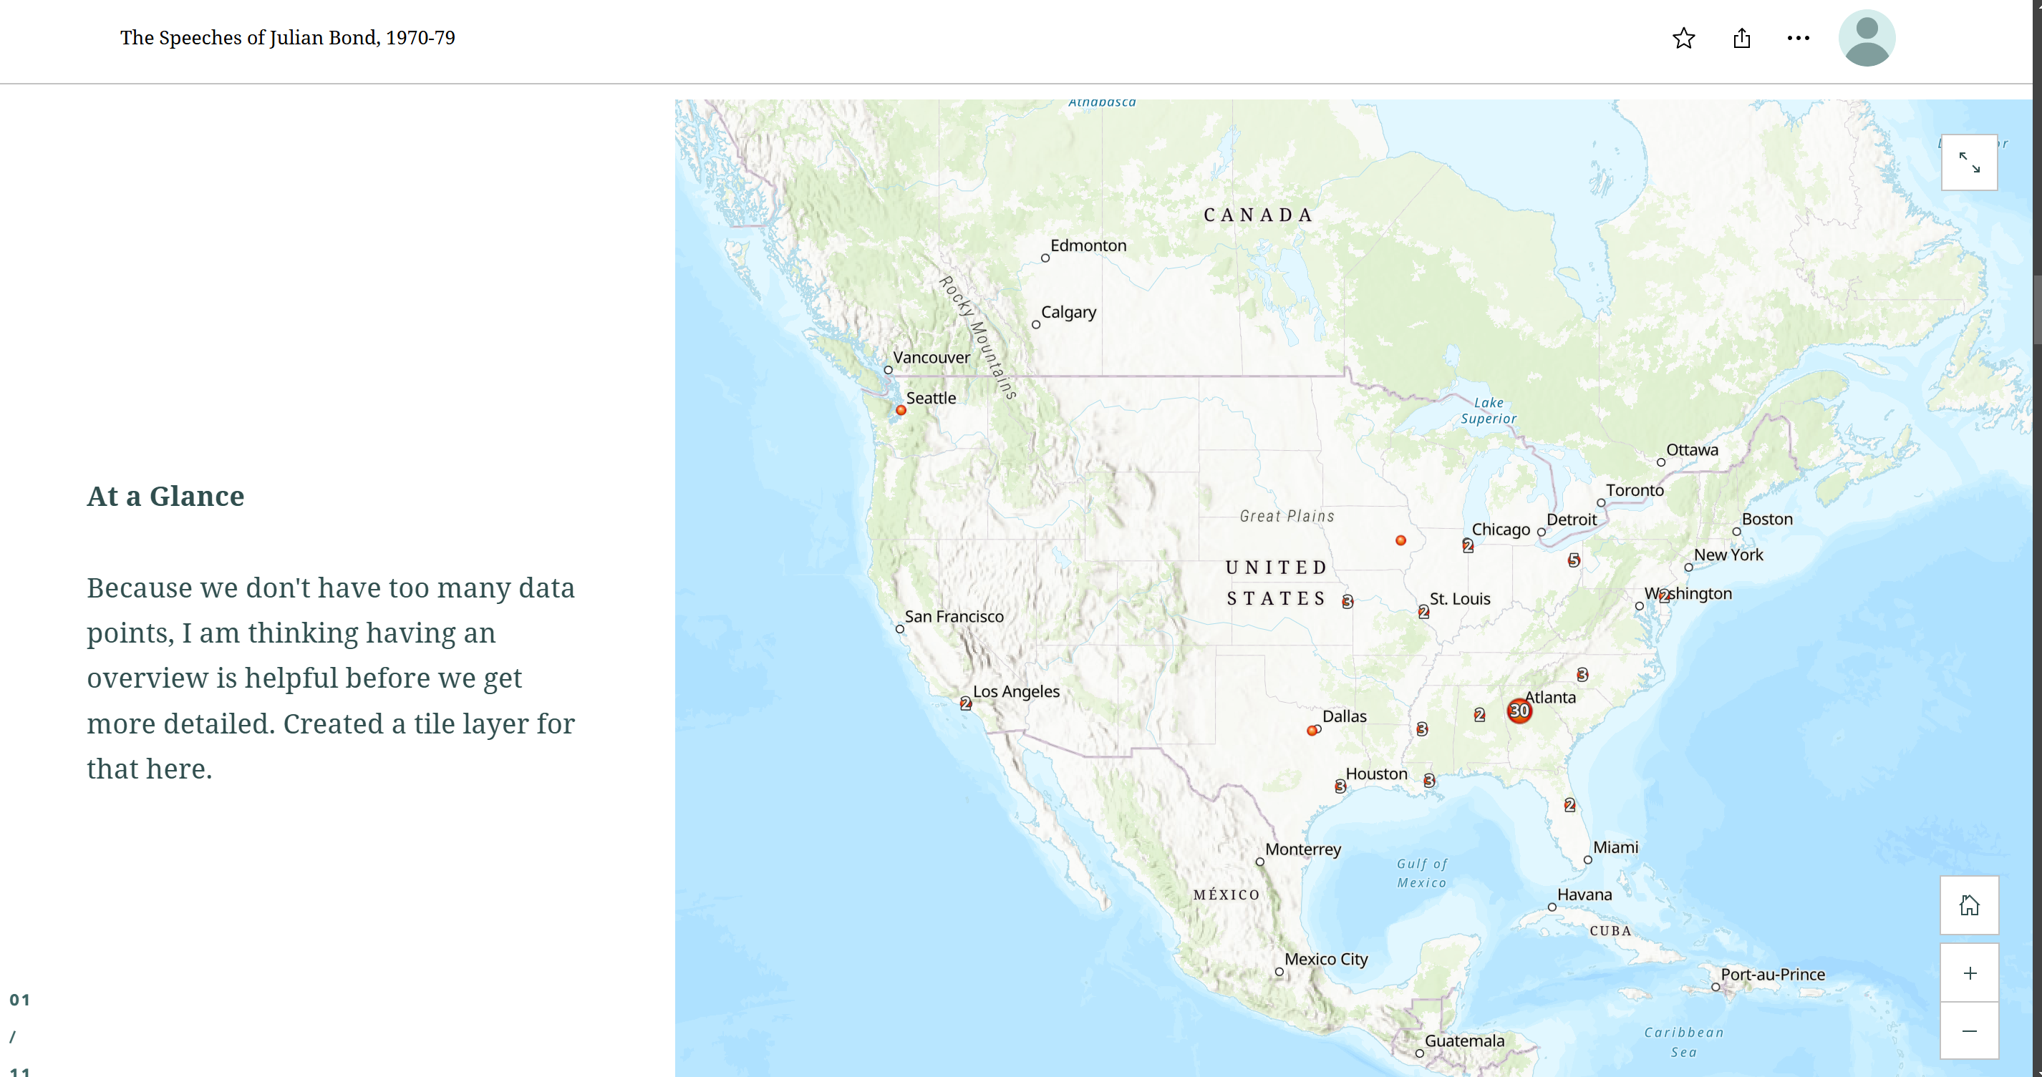

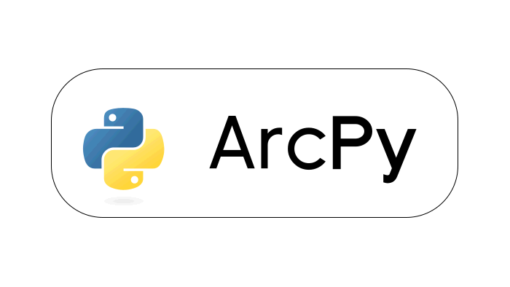
Mapping the Speeches of Julian Bond
In a super rough draft stage of development
Concept: users can visually interact with Bond’s speeches over time and space (links to Drupal content embedded)
Could extend to Series II
Limitations:
Currently manually adding tile layers (possibility of using ArcPy/AGOL Notebooks to automate)
Dates/locations fairly rudimentary (stalled during complications from Drupal migration)

Slide 10
Semantic Similarity Search: Tracing Bond’s Talking Points Over Time
Uses framework borrowed from a talk I went to by Lucian Li, DH Doctoral Candidate at UIUC
Uses modern language-model tools to explore connections between Bond’s work
Intended as an editorial tool, not necessarily user-facing
Primary challenge is connecting the script to our content
Script stores embeddings and similarities in relational schema
I. Tokenization (NLTK)
II. Generate embeddings (GTE-small)
III. Cosine similarity (SentenceTransformers)
IV. Aggregation/visualization

Slide 11
“I believe that armies, and navies are at the bottom the tinsel and braggadocio of oppression and wrong; and I believe that the wicked conquest of weaker and darker nations by nations white and stronger but foreshadows the death of that strength."

Slide 12
Some Closing Thoughts
Takeaways from DH talks
Looking into OCR transcription for some of the less exciting documents
Speech contracts etc.
Ability of LLMs to do well in correcting transcription errors
Use of LLMs through indirect prompting on the website (if we ever use them)
Allow users to choose from AI-generated options (document summaries etc.)
Write queries ourselves to ensure quality
Hopes for the Project
Stay current on DH trends/tools and protect our data
Have talked extensively with Dr. Baker about this
Teach all apprentices about good data practices
Continue to expand on variety of ways in which users can interact with Bond’s work
Map project may be the weakest but might one day be the best if we can properly expand upon it

Slide 13

Q & A Time

